Slide 1
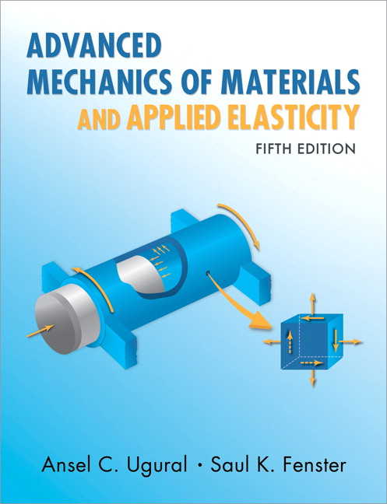
Advanced Mechanics
(Lecture 16)
ANNOUNCE / BUSINESS
Nothing is due next week - spring break
HW 08 due on Tuesday, March 18
PREVIOUS
Asymmetric bending
Finding neutral axis
TODAY
Shear stress in bending Shear center Shear flow

Slide 2
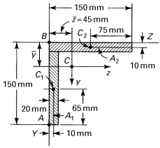

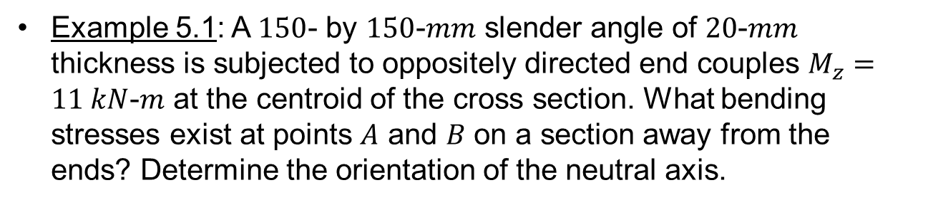
Example 5.1: A $150$- by $150$-$mm$ slender angle of $20$-$mm$ thickness is subjected to oppositely directed end couples $M_{z}=11 kN$-$m$ at the centroid of the cross section. What bending stresses exist at points $A$ and $B$ on a section away from the ends? Determine the orientation of the neutral axis.

Slide 3
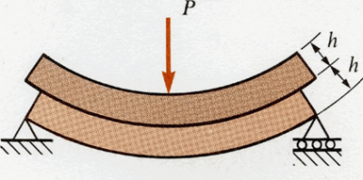
Shear Stress
Often ignored during failure analysis since it is small compared to normal stress in typical beams; becomes more important for short, stubby beams
Still plays important role in constraining bending of long beams
Notes:
right middle: show that for distributed load case application of stacked beam scenario, a beam with height 2h has ¼ the deflection of two beams with height h stacked on top of each other

Slide 4
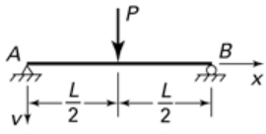

Shear Stress
Exercise: compare deflections of two stacked beams (left
Notes:
right middle: show that for distributed load case application of stacked beam scenario, a beam with height 2h has ¼ the deflection of two beams with height h stacked on top of each other

Slide 5

How do we quantify shear stress in bending beams?

Slide 6



Shear Center
Point in cross section through which the line of action of a force must pass in order to generate only bending (no torsion)
(quora.com)

Slide 7
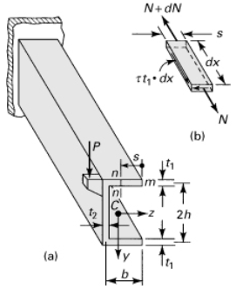
Shear Center
Independent of magnitude and direction of force
2 axes of symmetry: located at centroid
1 axis of symmetry: on axis of symmetry
May be located outside the cross section of beam
Not so important in solid or thick-walled beams since they have high resistance to torsion; more important in thin-walled beams

Slide 8
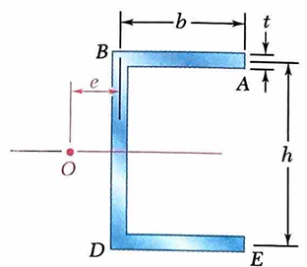
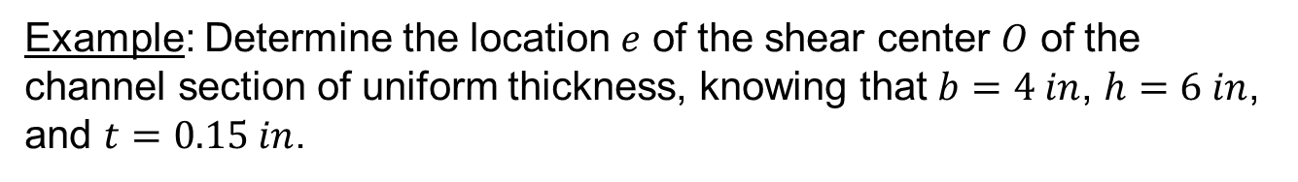
Example: Determine the location $e$ of the shear center $O$ of the channel section of uniform thickness, knowing that $b=4 in$, $h=6 in$, and $t=0.15 in$.

Slide 9
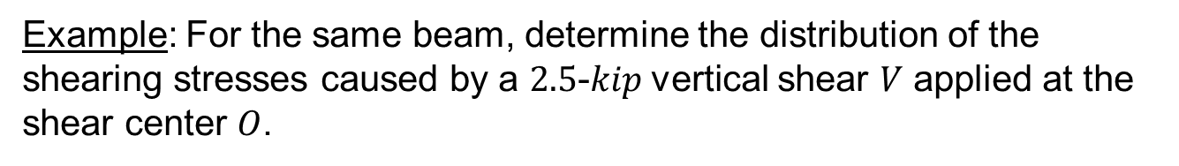
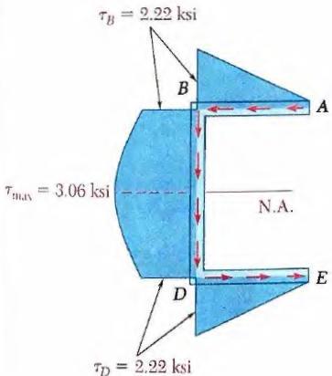
Example: For the same beam, determine the distribution of the shearing stresses caused by a $2.5$-$kip$vertical shear $V$ applied at the shear center $O$.

Slide 10
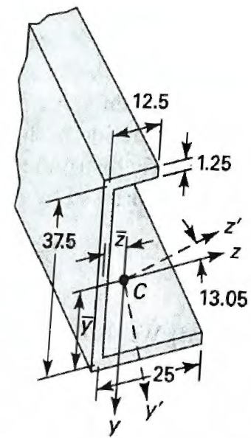
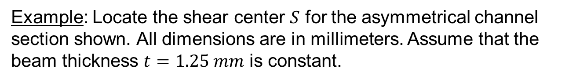
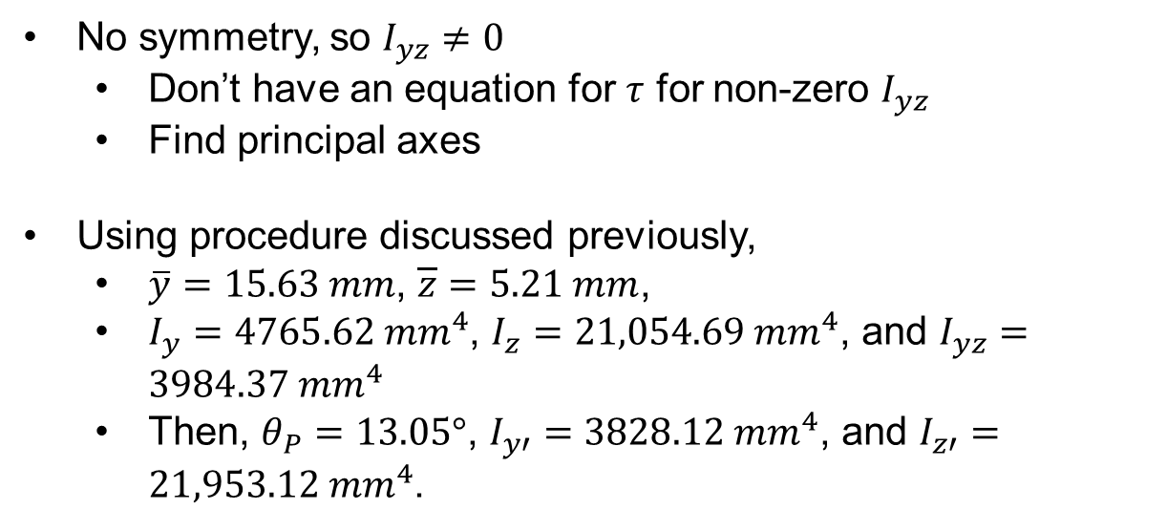
Example: Locate the shear center $S$ for the asymmetrical channel section shown. All dimensions are in millimeters. Assume that the beam thickness $t=1.25 mm$ is constant.
No symmetry, so $I_{yz}≠0$
Don’t have an equation for $τ$ for non-zero $I_{yz}$
Find principal axes
Using procedure discussed previously,
$\overline{y}=15.63 mm$, $\overline{z}=5.21 mm$,
$I_{y}=4765.62 {mm}^{4}$, $I_{z}=21,054.69 {mm}^{4}$, and $I_{yz}=3984.37 {mm}^{4}$
Then, $θ_{P}=13.05°$, $I_{y′}=3828.12{ mm}^{4}$, and $I_{z′}=21,953.12{ mm}^{4}$.

Slide 11
